Slide 1
Network Applications: TCP Socket Programming; File Transfer Protocol； HTTP/1.0
Qiao Xiang
https://qiaoxiang.me/courses/cnns-xmuf22/index.shtml
10/04/2022
This deck of slides are heavily based on CPSC 433/533 at Yale University, by courtesy of Dr. Y. Richard Yang.

Slide 2
Outline
Admin. and recap
Network application programming
UDP sockets
TCP sockets
Network applications (continue)
File transfer (FTP) and extension
HTTP
HTTP/1.0

Slide 3
Admin.
Lab assignment 2 due Oct. 13

Slide 4
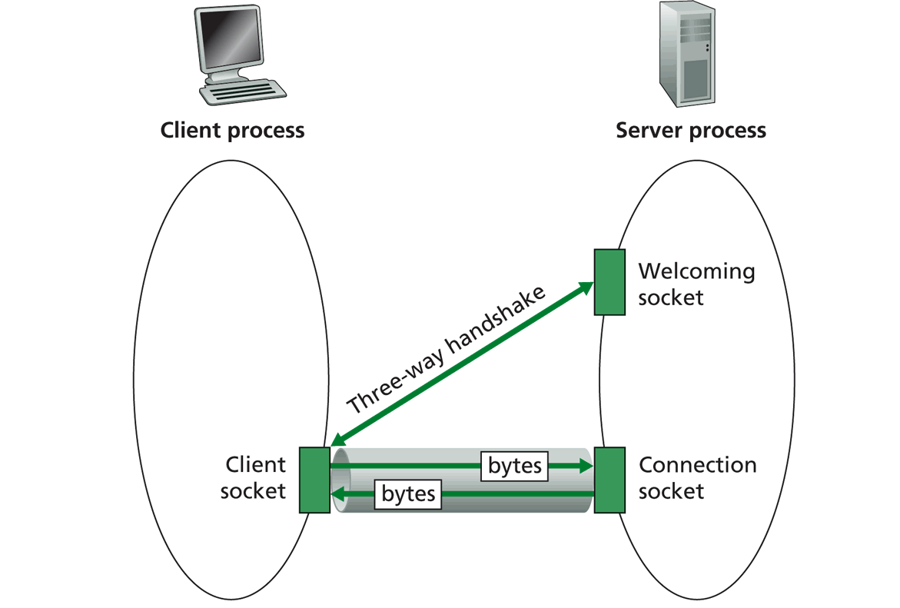
Recap: TCP Sockets
TCP server socket demux by 4-tuple:
source IP address
source port number
dest IP address
dest port number

Slide 5
Server Flow
Create ServerSocket(6789)
connSocket = accept()
read request from connSocket
Welcome socket: the waiting room
connSocket: the operation room
Serve the request
close connSocket

Slide 6
ServerSocket
ServerSocket()
creates an unbound server socket.
ServerSocket(int port)
creates a server socket, bound to the specified port.
ServerSocket(int port, int backlog)
creates a server socket and binds it to the specified local port number, with the specified backlog.
ServerSocket(int port, int backlog, InetAddress bindAddr)
creates a server with the specified port, listen backlog, and local IP address to bind to.
bind(SocketAddress endpoint)
binds the ServerSocket to a specific address (IP address and port number).
bind(SocketAddress endpoint, int backlog)
binds the ServerSocket to a specific address (IP address and port number).
Socket accept()
listens for a connection to be made to this socket and accepts it.
close()
closes this socket.

Slide 7
(Client)Socket
Socket(InetAddress address, int port)
creates a stream socket and connects it to the specified port number at the specified IP address.
Socket(InetAddress address, int port, InetAddress localAddr, int localPort)
creates a socket and connects it to the specified remote address on the specified remote port.
Socket(String host, int port)
creates a stream socket and connects it to the specified port number on the named host.
bind(SocketAddress bindpoint)
binds the socket to a local address.
connect(SocketAddress endpoint)
connects this socket to the server.
connect(SocketAddress endpoint, int timeout)
connects this socket to the server with a specified timeout value.
InputStream getInputStream()
returns an input stream for this socket.
OutputStream getOutputStream()
returns an output stream for this socket.
close()
closes this socket.

Slide 8
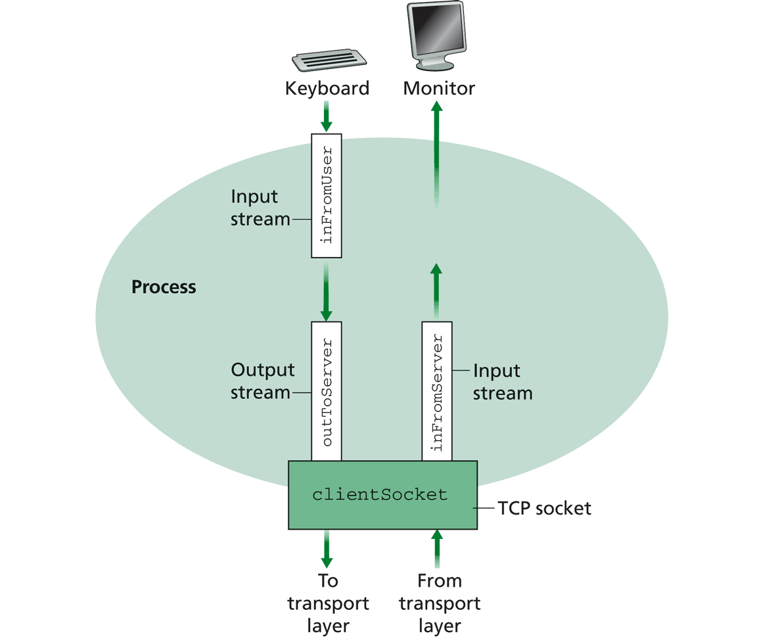
Simple TCP Example
Example client-server app:
1) client reads line from standard input (inFromUser stream) , sends to server via socket (outToServer stream)
2) server reads line from socket
3) server converts line to uppercase, sends back to client
4) client reads, prints modified line from socket (inFromServer stream)

Slide 9
Example: Java client (TCP)
import java.io.*;
import java.net.*;
class TCPClient {
public static void main(String argv[]) throws Exception
{
String sentence;
String modifiedSentence;
BufferedReader inFromUser =
new BufferedReader(new InputStreamReader(System.in));
sentence = inFromUser.readLine();
Socket clientSocket = new Socket(“server.name", 6789);
DataOutputStream outToServer =
new DataOutputStream(clientSocket.getOutputStream());
Create
input stream
Create
client socket,
connect to server
Create
output stream
attached to socket

Slide 10
OutputStream
public abstract class OutputStream
public abstract void write(int b) throws IOException
public void write(byte[] data) throws IOException
public void write(byte[] data, int offset, int length) throws IOException
public void flush( ) throws IOException
public void close( ) throws IOException

Slide 11
InputStream
public abstract class InputStream
public abstract int read( ) throws IOException
public int read(byte[] input) throws IOException
public int read(byte[] input, int offset, int length) throws IOException
public long skip(long n) throws IOException
public int available( ) throws IOException
public void close( ) throws IOException

Slide 12
Example: Java client (TCP), cont.
Send line
to server
outToServer.writeBytes(sentence + '\n');
BufferedReader inFromServer =
new BufferedReader(new
InputStreamReader(clientSocket.getInputStream()));
modifiedSentence = inFromServer.readLine();
System.out.println("FROM SERVER: " + modifiedSentence);
clientSocket.close();
}
}
Create
input stream
attached to socket
Read line
from server

Slide 13
Example: Java server (TCP)
import java.io.*;
import java.net.*;
class TCPServer {
public static void main(String argv[]) throws Exception
{
String clientSentence;
String capitalizedSentence;
ServerSocket welcomeSocket = new ServerSocket(6789);
while(true) {
Socket connectionSocket = welcomeSocket.accept();
BufferedReader inFromClient =
new BufferedReader(new
InputStreamReader(connectionSocket.getInputStream()));
Create
welcoming socket
at port 6789

Slide 14
Demo
% on MAC
start TCPServer
wireshark to capture our TCP traffic tcp.srcport==6789 or tcp.dstport==6789

Slide 15
Under the Hood: After Welcome (Server) Socket
server
client
128.36.232.5 128.36.230.2
198.69.10.10
TCP socket space
TCP socket space
state: listening
address: {*:6789, *:*}
completed connection queue:
sendbuf:
recvbuf:
state: starting
address: {198.69.10.10:1500, *:*}
sendbuf:
recvbuf:
local port
local addr
remote port
remote addr
state: listening
address: {*:25, *:*}
completed connection queue:
sendbuf:
recvbuf:
state: listening
address: {*:25, *:*}
completed connection queue:
sendbuf:
recvbuf:
%netstat –p tcp –n -a

Slide 16
After Client Initiates Connection
server
client
128.36.232.5 128.36.230.2
198.69.10.10
TCP socket space
TCP socket space
state: listening
address: {*:6789, *.*}
completed connection queue:
sendbuf:
recvbuf:
state: connecting
address: {198.69.10.10:1500, 128.36.232.5:6789}
sendbuf:
recvbuf:
state: listening
address: {*.25, *.*}
completed connection queue:
sendbuf:
recvbuf:
state: listening
address: {*.25, *.*}
completed connection queue:
sendbuf:
recvbuf:
%ubuntu java TCPClient <server> 6789

Slide 17
Example: Client Connection Handshake Done
server
client
128.36.232.5 128.36.230.2
198.69.10.10
TCP socket space
TCP socket space
state: listening
address: {*:6789, *:*}
completed connection queue: {128.36.232.5.6789, 198.69.10.10.1500}
sendbuf:
recvbuf:
state: connected
address: {198.69.10.10:1500, 128.36.232.5:6789}
sendbuf:
recvbuf:
state: listening
address: {*:25, *:*}
completed connection queue:
sendbuf:
recvbuf:
state: listening
address: {*:25, *:*}
completed connection queue:
sendbuf:
recvbuf:

Slide 18
Example: Client Connection Handshake Done
server
client
128.36.232.5 128.36.230.2
198.69.10.10
TCP socket space
TCP socket space
state: listening
address: {*.6789, *:*}
completed connection queue: sendbuf:
recvbuf:
state: connected
address: {198.69.10.10.1500, 128.36.232.5:6789}
sendbuf:
recvbuf:
state: established
address: {128.36.232.5:6789, 198.69.10.10.1500}
sendbuf:
recvbuf:
state: listening
address: {*.25, *:*}
completed connection queue:
sendbuf:
recvbuf:
state: listening
address: {*.25, *:*}
completed connection queue:
sendbuf:
recvbuf:
Packet demutiplexing is based on (dst addr, dst port, src addr, src port)
Packet sent to the socket with the best match!

Slide 19
Demo
What if more client connections than backlog allowed?
We continue to start java TCPClient

Slide 20
Example: Java server (TCP)
import java.io.*;
import java.net.*;
class TCPServer {
public static void main(String argv[]) throws Exception
{
String clientSentence;
String capitalizedSentence;
ServerSocket welcomeSocket = new ServerSocket(6789);
while(true) {
Socket connectionSocket = welcomeSocket.accept();
BufferedReader inFromClient =
new BufferedReader(new
InputStreamReader(connectionSocket.getInputStream()));
Wait, on welcoming
socket for contact
by client

Slide 21
Example: Server accept()
server
client
connectionSocket
128.36.232.5 128.36.230.2
198.69.10.10
TCP socket space
TCP socket space
state: listening
address: {*.6789, *:*}
completed connection queue: sendbuf:
recvbuf:
state: connected
address: {198.69.10.10.1500, 128.36.232.5:6789}
sendbuf:
recvbuf:
state: established
address: {128.36.232.5:6789, 198.69.10.10.1500}
sendbuf:
recvbuf:
state: listening
address: {*.25, *:*}
completed connection queue:
sendbuf:
recvbuf:
state: listening
address: {*.25, *:*}
completed connection queue:
sendbuf:
recvbuf:

Slide 22
Example: Java server (TCP): Processing
BufferedReader inFromClient =
new BufferedReader(new
InputStreamReader(connectionSocket.getInputStream()));
clientSentence = inFromClient.readLine();
capitalizedSentence = clientSentence.toUpperCase() + '\n'; DataOutputStream outToClient =
new DataOutputStream(connectionSocket.getOutputStream());
outToClient.writeBytes(capitalizedSentence);
}
}
}
Create input
stream, attached
to socket
Read in line
from socket

Slide 23
Example: Java server (TCP): Output
BufferedReader inFromClient =
new BufferedReader(new
InputStreamReader(connectionSocket.getInputStream()));
clientSentence = inFromClient.readLine();
capitalizedSentence = clientSentence.toUpperCase() + '\n'; DataOutputStream outToClient =
new DataOutputStream(connectionSocket.getOutputStream());
outToClient.writeBytes(capitalizedSentence);
}
}
}
Create output
stream, attached
to socket
Write out line
to socket
End of while loop,
loop back and wait for
another client connection

Slide 24
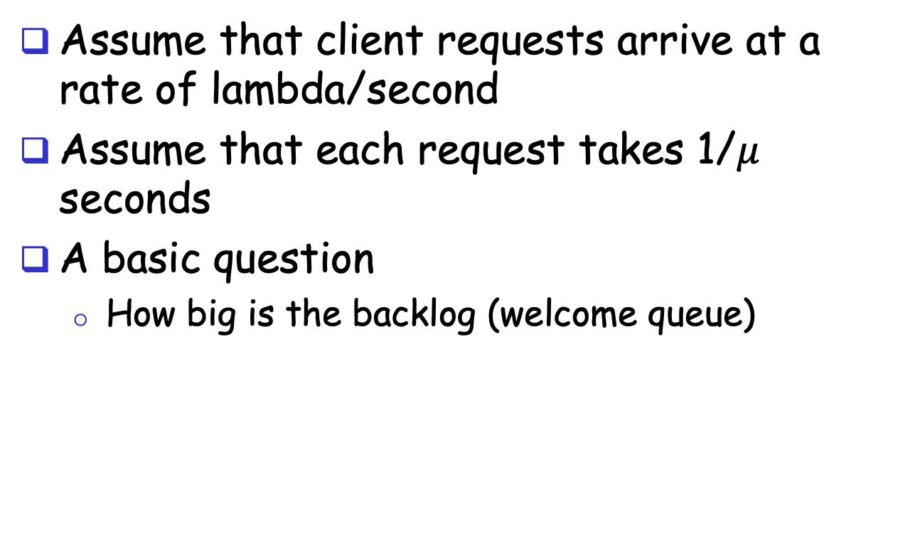
Analysis
Assume that client requests arrive at a rate of lambda/second
Assume that each request takes 1/$μ$ seconds
A basic question
How big is the backlog (welcome queue)
Welcome Socket Queue

Slide 25
Analysis
Is there any interop issue in the sample program?

Slide 26
Analysis
Is there any interop issue in the sample program?
DataOutputStream writeBytes(String) truncates
http://docs.oracle.com/javase/1.4.2/docs/api/java/io/DataOutputStream.html#writeBytes(java.lang.String)

Slide 27
Summary: Basic Socket Programming
They are relatively straightforward
UDP: DatagramSocket
TCP: ServerSocket, Socket
The main function of socket is multiplexing/demultiplexing to application processes
UDP uses (dst IP, port)
TCP uses (src IP, src port, dst IP, dst port)
Always pay attention to encoding/decoding

Slide 28
Outline
Admin. and recap
Network application programming
UDP sockets
TCP sockets
Network applications (continue)
File transfer (FTP) and extension

Slide 29

FTP: the File Transfer Protocol
FTP
user
interface
FTP
client
file transfer
FTP
server
user
at host
local file
system
remote file
system
Transfer files to/from remote host
Client/server model
client: side that initiates transfer (either to/from remote)
server: remote host
ftp: RFC 959
ftp server: port 21/20 (smtp 25, http 80)

Slide 30
FTP Commands, Responses
Sample commands:
sent as ASCII text over control channel
USER username
PASS password
PWD returns current dir
STAT shows server status
LIST returns list of file in current directory
RETR filename retrieves (gets) file
STOR filename stores file
Sample return codes
status code and phrase
331 Username OK, password required
125 data connection already open; transfer starting
425 Can’t open data connection
452 Error writing file
Notes:
PORT h1,h2,h3,h4,p1,p2 specifies the IP address and port the client receives its data

Slide 31
FTP Protocol Design
FTP
client
FTP
server
What is the simplest design of data transfer?
TCP control connection
port 21 at server
RETR file.dat
data

Slide 32
FTP: A Client-Server Application with Separate Control, Data Connections
Two types of TCP connections opened:
A control connection: exchange commands, responses between client, server.
“out of band control”
Data connections: each for file data to/from server
Discussion: why does FTP separate control/data connections?
Q: How to create a new data connection?
Notes:
A: someone (either server or client) needs to pick a new port

Slide 33
Traditional FTP: Client Specifies Port for Data Connection
FTP
client
FTP
server
TCP control connection
port 21 at server
PORT clientip:cport
RETR file.dat
Server initiates TCP data connection
server:20 clientip:cport

Slide 34
Example using telnet/nc
Use telnet for the control channel
telnet ftp.ietf.org 21
user anonymous
pass your_email
port 10,90,61,172,4,1
list
use nc (NetCat) to receive/send data with server
nc –v –l 1025
client
IP address
port
number
Notes:
telnet ftp.freebsd.org 21
user anonymous
pass 123
pasv

Slide 35
Problem of the Client PORT Approach
Many Internet hosts are behind NAT/firewalls that block connections initiated from outside
FTP
client
FTP
server
TCP control connection
port 21 at server
PORT clientip:cport
RETR file.dat
Server initiates TCP data connection
server:20 clientip:cport

Slide 36
FTP PASV: Server Specifies Data Port, Client Initiates Connection
FTP
client
FTP
server
FTP
client
FTP
server
TCP control connection
port 21 at server
TCP control connection
port 21 at server
PORT clientip:cport
PASV
serverip:sport
RETR file.dat
RETR file.dat
Server initiates TCP data connection
server:20 clientip:cport
Client initiates TCP data connection
of PASV returned serverip:sport

Slide 37
Example
Use Wireshark to capture FTP traffic
Using chrome to visit ftp://ftp.freebsd.org

Slide 38
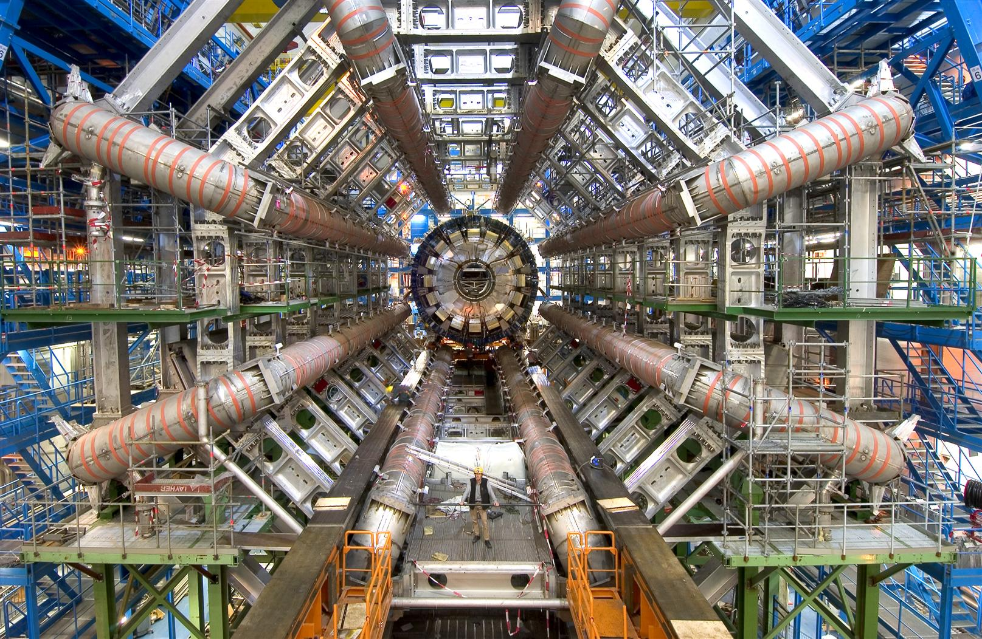
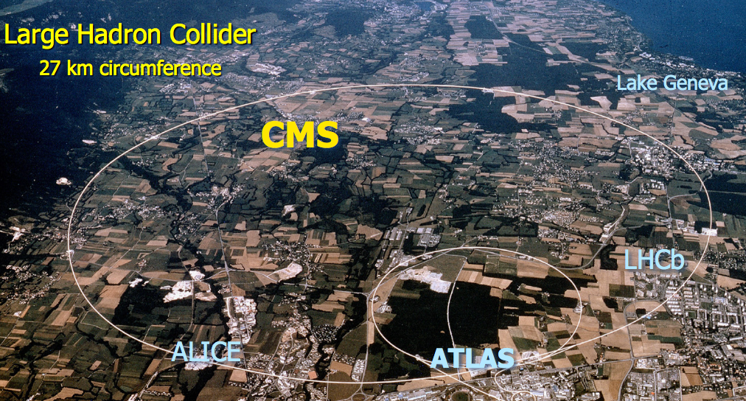
FTP Extensions
FTP with extensions are being used extensively in large data set transfers (e.g., LHC)

Slide 39
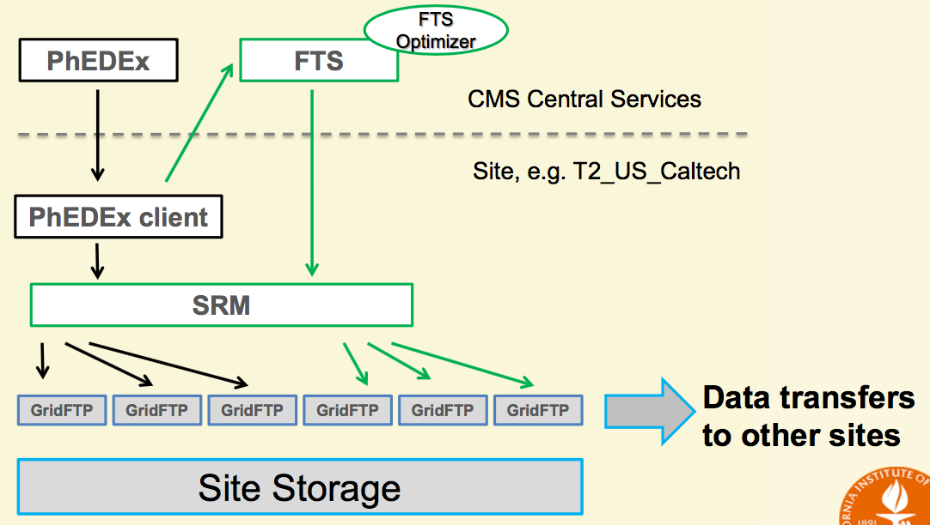
Data Transfer Structure
See GridFTP to FTP extensions
https://www.ogf.org/documents/GFD.20.pd
Goal of GridFTP: allow parallel, high-throughput data transfer
Discussion: What features do we need to add to FTP to allow parallel transfers?

Slide 40
FTP Evaluation
application
transport
network
data link
physical
request
Key questions to ask about a C-S application
- Is the application extensible?
- Is the application scalable?
- How does the application handle server failures (being robust)?
- How does the application provide security?
reply
application
transport
network
data link
physical
What are some interesting design features of the FTP protocol?

Slide 41
Outline
Admin. and recap
Network application programming
UDP sockets
TCP sockets
Network applications (continue)
File transfer (FTP) and extension
HTTP

Slide 42
From Opaque Files to Web Pages
Web page:
authored in HTML
addressed by a URL
URL has two components:
host name, port number and
path name
Most Web pages consist of:
base HTML page, and
several referenced objects
E.g., image
http request
User agent: Explorer
http response
http://qiaoxiang.me:80/index.html
http request
Server
running
Apache Web
server
http response
User agent:
Firefox
The Web pages are requested through HTTP: hypertext transfer protocol

Slide 43
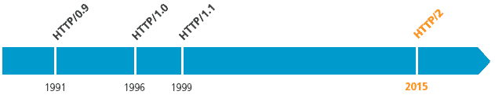
HTTP is Still Evolving
RFC 1945
RFC 2068
RFC 7540

Slide 44
HTTP 1.0 Message Flow
Server waits for requests from clients
Client initiates TCP connection (creates socket) to server, port 80
Client sends request for a document
Web server sends back the document
TCP connection closed
Client parses the document to find embedded objects (images)
repeat above for each image

Slide 45
HTTP 1.0 Message Flow (more detail)
0. http server at host qiaoxiang.me waiting for TCP connection at port 80.
Suppose user enters URL qiaoxiang.me/index.html
1a. http client initiates TCP connection to http server (process) at qiaoxiang.me. Port 80 is default for http server.
1b. server “accepts” connection, ack. client
2. http client sends http request message (containing URL) into TCP connection socket
3. http server receives request message, forms response message containing requested object (index.html), sends message into socket (the sending speed increases slowly, which is called slow-start)
time

Slide 46
HTTP 1.0 Message Flow (cont.)
4. http server closes TCP connection.
5. http client receives response message containing html file, parses html file, finds embedded image
time
6. Steps 1-5 repeated for each of the embedded images

Slide 47
Discussion
How about we use FTP as HTTP?
FTP
client
FTP
server
FTP
client
FTP
server
TCP control connection
port 21 at server
TCP control connection
port 21 at server
PORT clientip:cport
PASV
serverip:sport
RETR index.html
RETR index.html
Server initiates TCP data connection
server:20 clientip:cport
Client initiates TCP data connection
of PASV returned serverip:sport
Notes:
Content negotiation, content type indication

Slide 48
HTTP1.0 Message Flow
HTTP1.0 servers are stateless servers: each request is self-contained
FTP
client
FTP
server
HTTP
client
HTTP
server
USER xxx
PASS xxx
CWD home
PORT clientip:cport
GET /home/index.html USER: xxx PASS: xxx
RETR index.html
Server initiates TCP data connection
server:20 clientip:cport
Server sends file on same connection

Slide 49
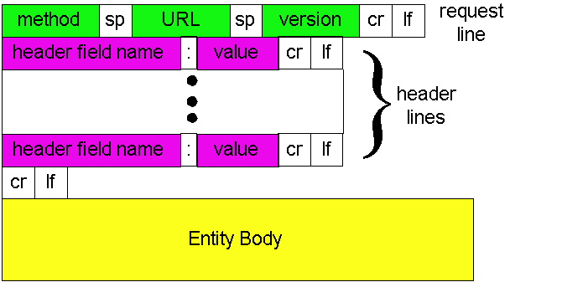
HTTP Request Message: General Format
ASCII (human-readable format)

Slide 50
Trying out HTTP (client side) for yourself
1. Telnet to your favorite Web server:
telnet qiaoxiang.me 80
Opens TCP connection to port 80
(default http server port) at qiaoxiang.me.
Anything typed in sent
to port 80 at qiaoxiang.me
2. Type in a GET http request:
GET /index.html HTTP/1.0
By typing this in (hit carriage
return twice), you send
this minimal (but complete)
GET request to http server
3. Look at response message sent by the http server.

Slide 51
Trying out HTTP (client side) for yourself
Try telnet GET on www.xmu.edu.cn

Slide 52
HTTP Request Message Example: GET
Virtual host multiplexing
request line
(GET, POST,
HEAD, PUT, DELETE, TRACE … commands)
GET /somedir/page.html HTTP/1.0 Host: www.somechool.edu Connection: close
User-agent: Mozilla/4.0
Accept: text/html, image/gif, image/jpeg
Accept-language: en
(extra carriage return, line feed)
Connection management
header
lines
Carriage return,
line feed
indicates end
of message
Content negotiation

Slide 53
HTTP Response Message
status line
(protocol
status code
status phrase)
HTTP/1.0 200 OK
Date: Wed, 23 Jan 2008 12:00:15 GMT
Server: Apache/1.3.0 (Unix)
Last-Modified: Mon, 22 Jun 1998 …...
Content-Length: 6821
Content-Type: text/html
data data data data data ...
header
lines
data, e.g.,
requested
html file

Slide 54
HTTP Response Status Codes
In the first line of the server->client response message. A few sample codes:
200 OK
request succeeded, requested object later in this message
301 Moved Permanently
requested object moved, new location specified later in this message (Location:)
400 Bad Request
request message not understood by server
404 Not Found
requested document not found on this server
505 HTTP Version Not Supported

Slide 55
Trying Use Chrome to visit Course Page

Slide 56
Design Exercise
Workflow of an HTTP server processing a GET request that maps to a file: GET /somedir/page.html HTTP/1.0 Host: www.somechool.edu

Slide 57
Basic HTTP Server Workflow
Create ServerSocket(6789)
128.36.232.5 128.36.230.2
TCP socket space
state: listening
address: {*.6789, *.*}
completed connection queue: sendbuf:
recvbuf:
connSocket = accept()
read request from connSocket
state: established
address: {128.36.232.5:6789, 198.69.10.10.1500}
sendbuf:
recvbuf:
Map URL to file
state: listening
address: {*.25, *.*}
completed connection queue:
sendbuf:
recvbuf:
Read from file/ write to connSocket
close connSocket

Slide 58
Example Code
See BasicWebServer.java
Try using telnet and real browser, and fetch
file1.html
index.html
what difference in behavior?

Slide 59
Static -> Dynamic Content
Create ServerSocket(6789)
connSocket = accept()
It does not have to be a static file
read request from connSocket
Map URL to file
Read from file/ write to connSocket
close connSocket

